Slide 1
Ear Training, Movement and the Choral Rehearsal
Dr. Ellen Gilson Voth
Guest faculty, Western CT State Univ.
CMEA In-service Conference
Thursday, April 11 – 4:30-5:30 pm
www.ellengilsonvoth.net
egvoth@snet.net

Slide 3
Haydn - recording
https://www.youtube.com/watch?v=p4lSauxyFWo

Slide 4
“We only know we have done our job as ________ teachers if students can exhibit sensitivity to musical chiaroscuro. We can’t really tell if they have learned anything about how tonality itself actually operates…simply by observing if they sing the right notes...because those ‘right notes’ may be performed in an antimusical way.”
- quote from M.R. Rogers, Journal of Music Theory Pedagogy (2000).

Slide 5
Balancing the scale: Loyalty Freedom

Slide 7
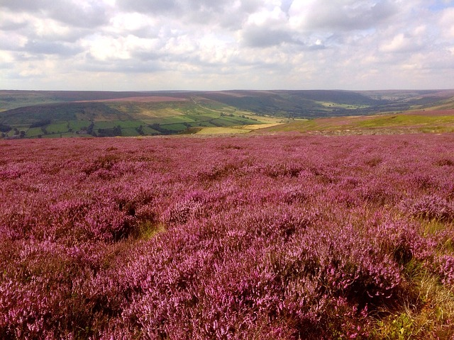
Music
“I never saw a moor” – SA, pub. by Santa Barbara Music Publishing.
“I never saw a moor, never saw the sea, but I know how the heather looks and what a wave must be.” (Text by Emily Dickinson). Composed by Neil Ginsberg.
https://www.youtube.com/watch?v=sjYGUG51KwA

Slide 8
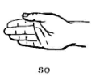
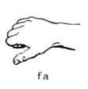
Music
“Freedom is coming” – South African (collected by Anders Nyberg). Three part, arr. Henry Leck

Slide 9
Music
“Hamisha Asar” – Flory Jagoda, arr. Nick Page. Published by Boosey and Hawkes. (SSA/SATB).
https://www.youtube.com/watch?v=g-kWND76Vg8
https://www.youtube.com/watch?v=y4wO-Q9JuV4

Slide 10
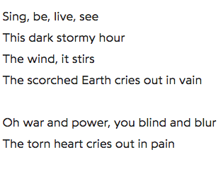
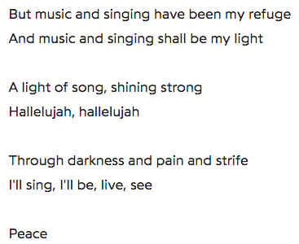
Music
“Earth Song” – Frank Ticheli. SATB, pub. by Hinshaw.
https://www.youtube.com/watch?v=Aarowtnr-hs

Slide 11
Ear Training, Movement and the Choral Rehearsal
Dr. Ellen Gilson Voth
Guest faculty, Western CT State Univ.
Thursday, April 11 – 4:30-5:30 pm
www.ellengilsonvoth.net
egvoth@snet.net

